Slide 1
EDS/SOC 117
Week 2, tuesday
Culture, diversity, and the language of inequality

Slide 2
reminders
Self-selection for discussion groups during Thursday’s lecture – email me the names by Sunday, January 20th (not the same as discussion section)
Roughly 6-7 people per group

Slide 3
Common assumptions
Negative beliefs about cultural differences or diversity influence schools, teachers, and students:
  How schools are structured – tracking/ability grouping, resources, assigning teachers
  Teachers left on their own to figure out why some groups do better than others
  Students often blame themselves for failures

Slide 4
Longstanding Conversation in Social Science: What Determines Our success or failure?
Institutions in society
Individual choice, free will
Economic
Health
Education
Social
Legal
Political
Religious
Etc.
Family
Self
Neighborhood
Friends
School
Peers
Church
Etc.
LIFE
What role does education play in shaping our pathways in life?

Slide 5
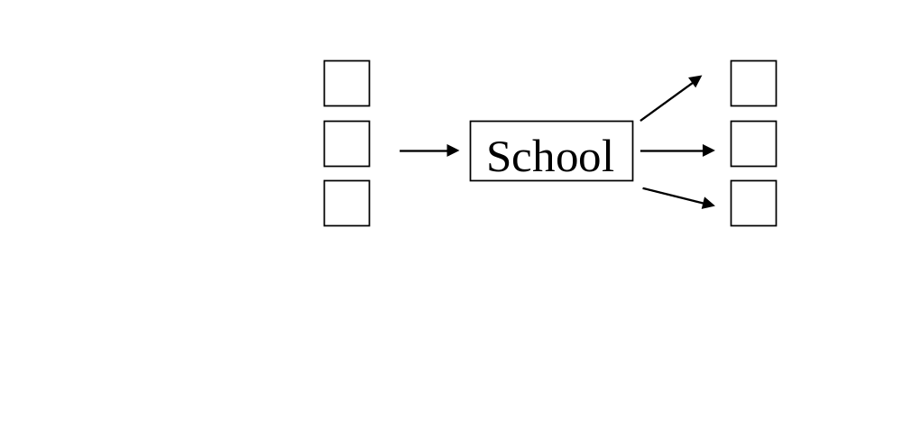
View #1: Schools as provider of equal opportunity
High income
Middle income
Low income
Family Background
Occupation

Slide 6

View #2: Schools reproduce social inequalities (Economic model)
School
High Income
Middle Income
Low Income
Family Background
Occupation

Slide 7
Anyon , Social Class and the Hidden Curriculum of Work
Social Class | Typical Parent Occu. | Schoolwork | Teacher Rewards
Working class | Stockroom worker, storeroom worker, auto mechanics, gas station attendants, security guard | Following steps for a mechanical procedure, involving rote behavior, little student choice; teachers rarely explain | Following the correct steps and not necessarily doing the work correctly
Middle class | Blue-collar “rich,” carpenters, construction workers, office jobs, city employees, accountants | Getting the right answer to get a good grade; following directions leads to right answers but so does student decision-making | Getting the right answer which is found in books or by listening to the teacher
Affluent professional | Cardiologist, corporate lawyer, engineer, advertising executive | Working independently, creatively to express ideas, concepts | Quality of individual expression, appropriateness to the task
Executive elite | Top executives in multi-national corporations | Developing analytic skills and intellect to solve complex problems | Quality of thinking; high level intellectual ideas

Slide 8
Education is never neutral
Education is always political – there’s always a power struggle to control views about human worth, the meaning of cultural/racial differences, and who’s most deserving of a high quality education.
Even terms like equal education or equitable education reflect societal competitions to control the meaning.

Slide 9
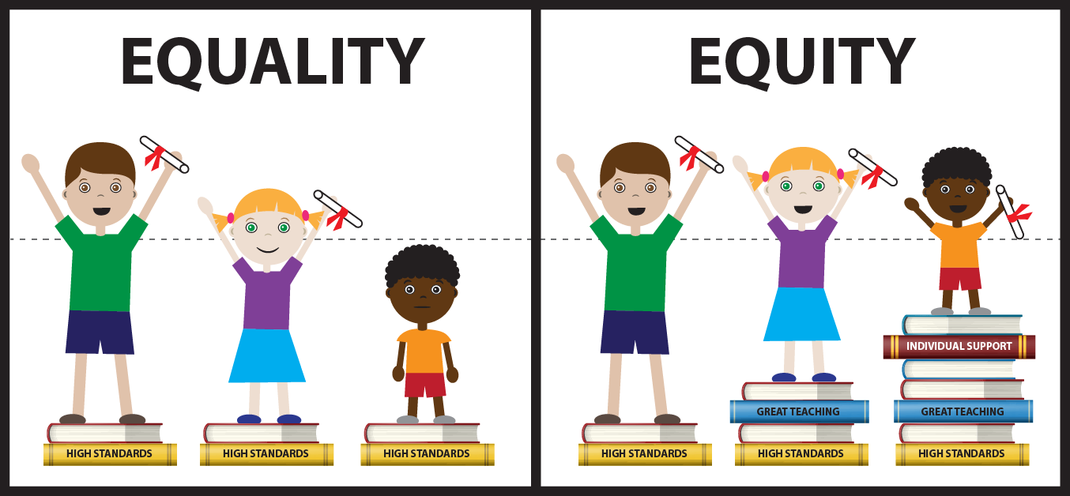

Slide 10
What Difference Does Difference Make?
(in our society, our lives and in education)
Public interest in educational inequality puts a spotlight on questions about the influence of social categories – e.g., gender, class, race/ethnicity, language, culture, religion, sexual orientation, physical ability, mental/cognitive ability, etc.
Are schools the problem or individual choices due to students’ family or cultural background?
These categories are important, but we need caution in our generalizations about them.
Societal values and beliefs influence how people perceive “difference.”

Slide 11
The Social Construction of Race
RACE: Are We So Different? A 2009 project of the American Anthropological Association, funded by the Ford Foundation and the National Science Foundation
The Story of Race: A History http://www.youtube.com/watch?v=No5ai6LZLFg&feature=channel&list=UL

Slide 12
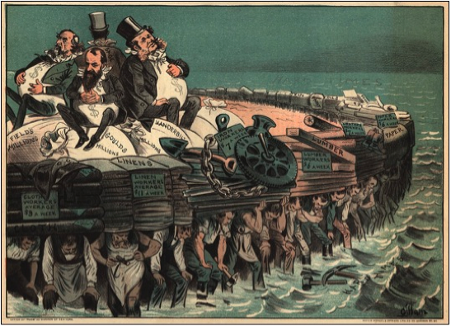
Notes:
“on the backs of Irish” 1800’s

Slide 13
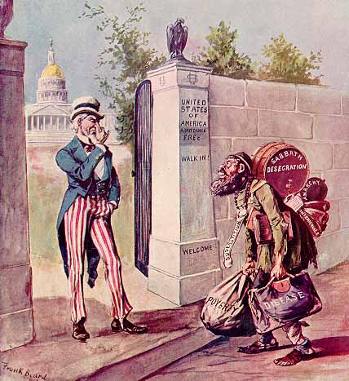
Notes:
Anti-immigration sentiment 1896

Slide 14
Legal Examples: Race & Rights
1800’s- Mexicans were seen as a nationality (i.e., a group tied to country of Mexico) and as belonging to a racial group – white, black, Indian, Asian – depending on physical features. As U.S. expansion grew in Texas & CA, animosity and prejudice increased. Once U.S. took over Mexican territory in CA and TX laws quickly followed that reflected prejudices. Laws re-defined Mexicans as “distinct” from other groups and inferior compared to other groups.
Haney Lopez, I.F. Winter 1994. “The Social Construction of Race: Some Observations on Illusion, Fabrication, and Choice. Harvard Civil Rights-Civil Liberties Law Review, 29:1, pp. 1-62.

Slide 15
Legal Examples: Race & Rights
1806- Black woman sued for freedom from slavery in Virginia. Court decision based on skin color and hair texture. Long, straight “Indian” hair meant she was less African and more Indian.
1909- Four Armenians sued to establish their racial eligibility for U.S. citizenship. Armenians had been categorized as “Asiatics” and were usually denied citizenship, which was only available to whites, some Africans. Court re-examined which groups could be considered “white” and ultimately granted citizenship to the Armenians, a group not considered a “threat” to society.
Haney Lopez, I.F. Winter 1994. “The Social Construction of Race: Some Observations on Illusion, Fabrication, and Choice. Harvard Civil Rights-Civil Liberties Law Review, 29:1, pp. 1-62.

Slide 16
Legal Examples: Race & Rights
1922- Japanese-born immigrant applied for U.S. citizenship. Court had to debate definition of race by skin color. Court rejected man’s petition and realized that using skin color as a test of race was inadequate.
1981- Arab man sued for racial discrimination. Court had to first decide if Arabs were a racial group other than White. Court decision said Arabs were a “distinct” racial group based on facial features.
Haney Lopez, I.F. Winter 1994. “The Social Construction of Race: Some Observations on Illusion, Fabrication, and Choice. Harvard Civil Rights-Civil Liberties Law Review, 29:1, pp. 1-62.

Slide 17
Interracial marriage complicates racial labels
Miscegenation - a marriage between persons of different races.
Banned by law in all states until 1967.
In 1967, the U.S. Supreme Court held that laws banning interracial marriages are unconstitutional.
The last remaining state-law ban on interracial marriages was a provision in the Alabama constitution. The Alabama legislature voted to repeal the ban. In 1999, subject to a vote by the people, the repeal became effective in 2000.

Slide 18
Language changes over time
Nieto writes, “Language is always changing. Because it mirrors social, economic, and political events, it is an important barometer of a society at any given time. Language also becomes obsolete; it could not be otherwise because it is a reflection of societal changes” (pg. 24).
(Hispanic, Chicano/a, Latino/a, Latinx, Negro, Black, African American, Oriental, Asian, Caucasian, White, European American)

Slide 19
Silence, fear, denial
Nieto writes: “Society categorizes people according to visible and invisible traits, uses classifications to deduce fixed behavioral and mental traits, and then applies policies and practices that jeopardize some groups and benefits other groups. Classifications based on race, ethnicity, gender, social class, religion, culture are all around us; frequently they result in gross exaggerations or stereotypes.”

Slide 20
Case study: Linda Howard
1. What does culture mean for Linda? Does her view of herself match how others view her?
2. She thinks “we’re all racist in a sense.” Do
you think there’s some truth to this?
3. One of her teachers said she can go to Harvard and talk with people, and she can go out in the street and “rap with y’all.” Linda loves this – having her “street talk” and being able to “talk properly.” This reflects perceptions about language and being successful. Why is Linda’s view important?

Slide 21
Case study: rich miller
1. Rich has a strong sense of self instilled by his mother who pushes education. Yet, his experiences in society and in a mostly African American school contradict this message. Discuss his school experiences and how they influenced how he sees himself as a student.
2. Even with a strong identity, Rich shares some negative perceptions about his race. How have these negative perceptions affected him?
3. What do you think he means by, “Self-respect is one gift that you give yourself?

Slide 22
Case study: Vanessa Mattison
1. Vanessa seemed uncomfortable discussing racial, class or cultural differences. Her approach was that differences are not important – the “color-blind” approach. Why is this approach harmful to all students?
2. The author (Nieto) writes that research shows that Whites students are much less likely than students of color to identify ethnicity as important to their identity. Why do you think that’s the case? Are there exceptions?

Slide 23
For Thursday
We’ll talk about the concept of culture. What is culture?
How does school culture impact students?

